Slide 1

Chapter 15
Django Third-Party Libraries

Slide 2

Objectives
This chapter introduces you to Django third-party libraries.
You will configure your database connection using URLs with dj-database-urls and inspect and debug your application with the Django Debug Toolbar.

Slide 3
django-configurations
We will need to switch to a production configuration, and that's when we will use django-configurations.
To install django-configurations, use pip3 as follows:

Slide 4
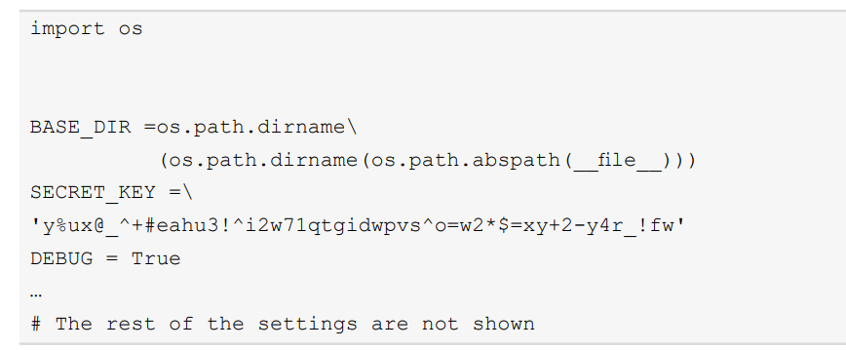
django-configurations
We can illustrate what needs to be done to the settings file by just showing the first few settings in the file. A standard Django settings.py file normally starts like this.

Slide 5
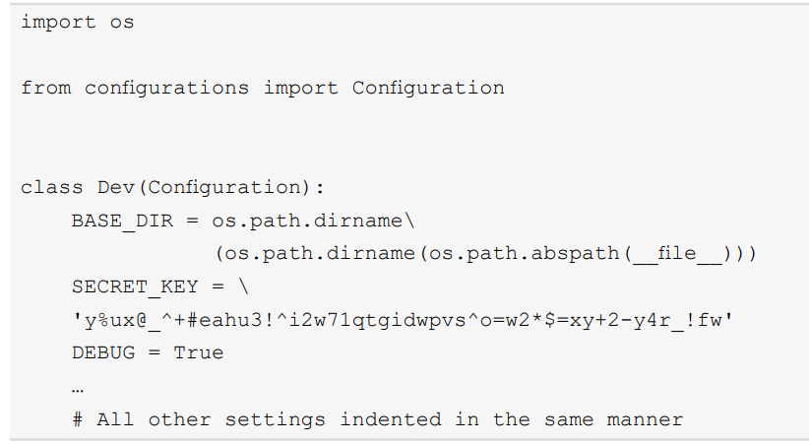
django-configurations
To convert the settings to django-configurations, first import Configuration from configurations.

Slide 6
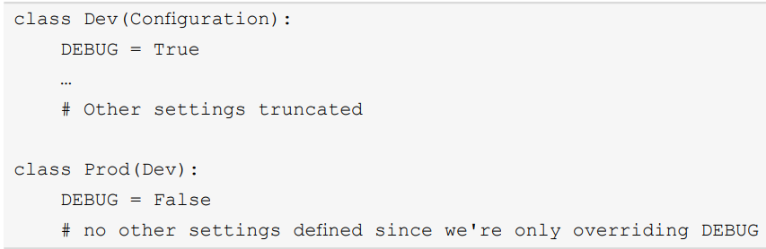
django-configurations
A Prod class can be defined that extends Dev and sets DEBUG.

Slide 7
manage.py changes
There are two lines that need to be added/changed in manage.py to enable django-configurations.

Slide 8
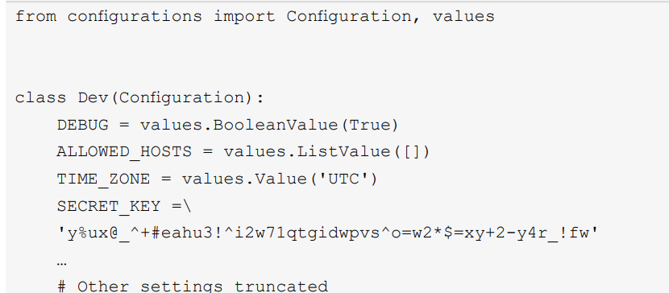
Configuration from Environment Variables
We will allow DEBUG, ALLOWED_ HOSTS, TIME_ZONE, and SECRET_KEY to be set with environment variables as follows.

Slide 9

dj-database-url
The URL's format will differ slightly depending on whether you are using a local SQLite database or a remote database server. To use SQLite on disk (as Bookr is currently), the URL is like this:

Slide 10

dj-database-url
Note there are three slashes present. This is because SQLite doesn't have a hostname, so this is like a URL being like this.

Slide 11
dj-database-url
That is, the URL has a blank hostname. All three slashes are therefore together. To build a URL for a remote database server, the format is usually like this.

Slide 12

django-crispy-forms
django-crispy-forms acts as an intermediary between Django Forms and Bootstrap forms. It can take a Django form and render it with the correct Bootstrap elements and classes.

Slide 13
django-crispy-forms
This is done with the CRISPY_TEMPLATE_PACK setting. In our case, it should be set to bootstrap4.

Slide 14

The crispy Filter
The first method of rendering a form with django-crispy-forms is by using the crispy template. First, the filter must be loaded in the template. The library name is crispy_forms_tags.

Slide 15
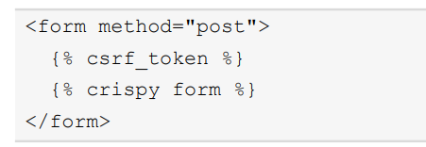
The crispy Template Tag
How does this differ from the crispy filter? The crispy template tag will also render the <form> element and {% csrf_token %} template tag for you. So, consider for example that you used it like this:

Slide 16
django-allauth

Slide 17
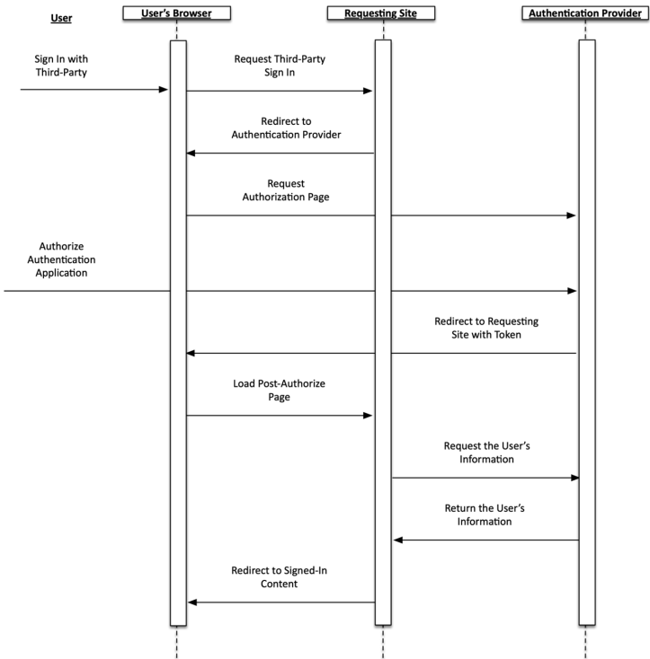
Third-party authentication flow

Slide 18
GitHub Auth Setup
A new GitHub application can be set up under your GitHub profile.
After creating the app, it will provide a Client ID and Client Secret. These are your Client id and Secret key, respectively, in django-allauth.

Slide 19
Google Auth Setup
The creation of a Google application is done through your Google Developers console.
The app's Client ID is also Client id in djangoallauth, and the app's Client secret is the Secret key.

Slide 20
Initiating Authentication with django-allauth
To initiate authentication through a third-party provider, you first need to add the django-allauth URLs in your URL maps. Somewhere inside your urlpatterns is one of your urls.py files, include allauth.urls

Slide 21
Summary
In this chapter, we introduced five third-party Django apps that can enhance your website.
We installed and set up django-configurations, which allowed us to easily switch between different settings and change them using environment variables.

Slide 22
Summary
dj-database-url also helped with settings, allowing us to make database settings changes using URLs.
django-crispy-forms can not only render our forms using the Bootstrap CSS but also lets us save code by defining their behavior as part of the form class itself.

